Slide 1
Labconco & Avantor
Courtney Gatter-Technical Sales Representative
Andy Miller-Eastern Regional Sales Manager

Slide 2
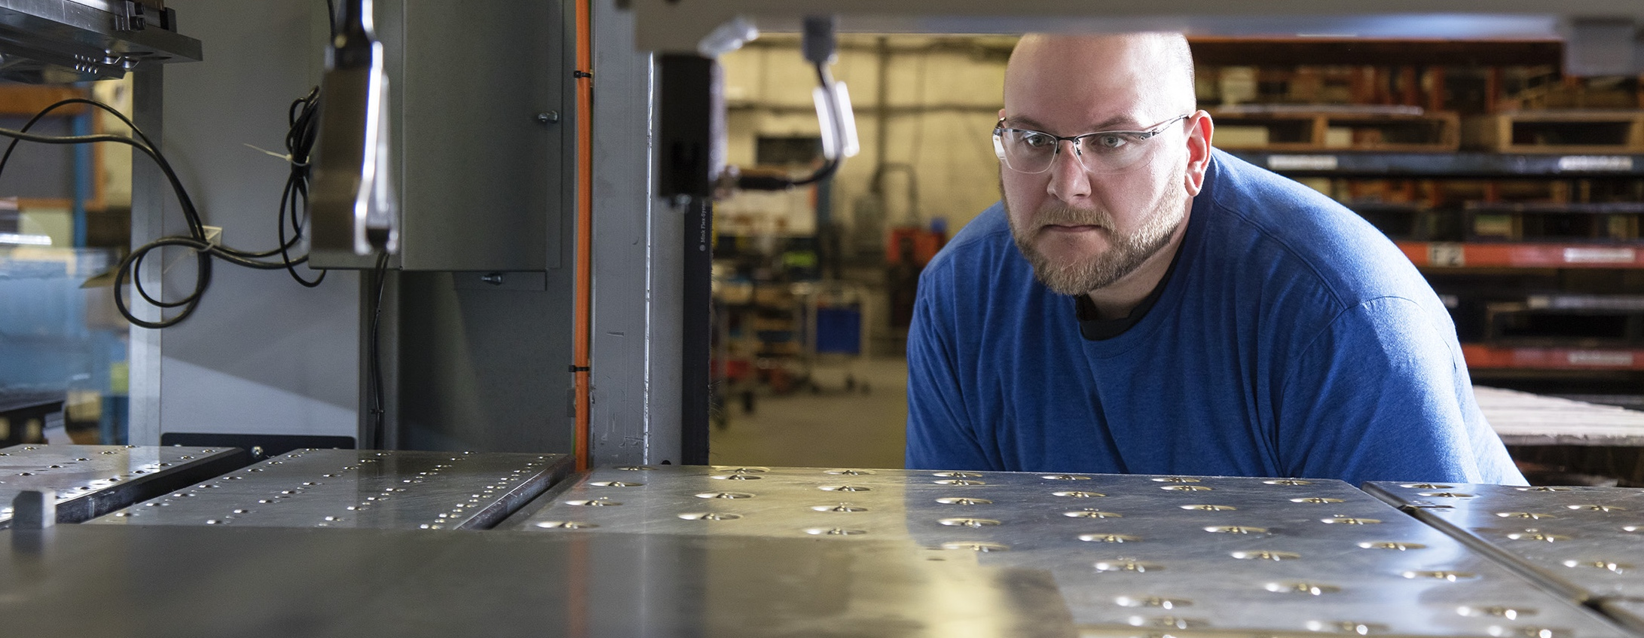
About us.
Labconco was incorporated in 1925 by Ralph Callaway and Phillip Goldfisch
Based in Kansas City, Missouri
First product was Kjeldahl nitrogen determination apparatus for grain protein analysis
Two manufacturing locations handle multiple product lines:
Kansas City, MO
Fort Scott, KS

Slide 3
Everything you need to succeed.
Safety Ventilation
Fume Hoods
Filtered Fume Hoods
Ductless Enclosures
Biosafety Cabinets
Clean Benches
PCR Enclosures
Lab Animal Enclosures
Powder Containment
Nanotechnology
Glove Boxes
Forensics
Sample Preparation
Freeze Dryers
Evaporators
Concentrators
Cold Traps
Washers & Water
Glassware Washers
Water Purification Systems
Lab Accessories & Parts
Vacuum Pumps
Vacuum Desiccators
Remote Blowers & Exhausters
Filters & Pre-Filters
Glassware
Carts, Tables & Benches
Base Stands, Cabinets & Work Surfaces

Slide 4
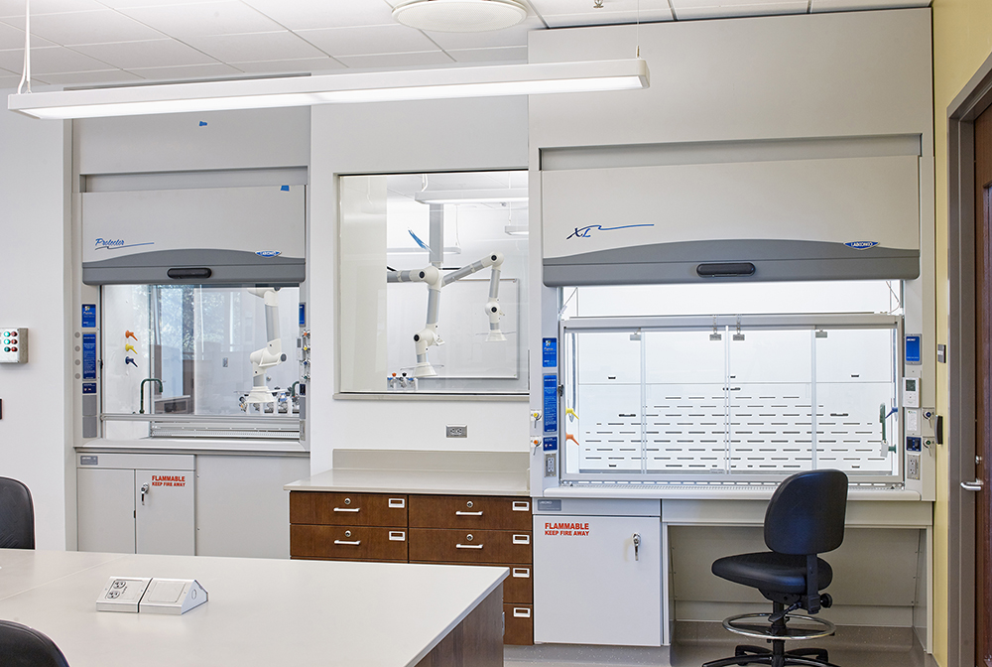
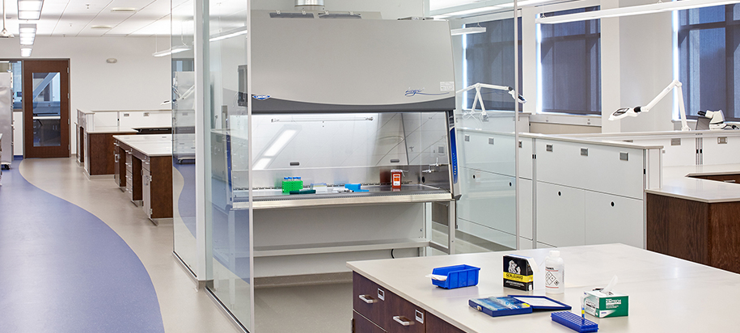
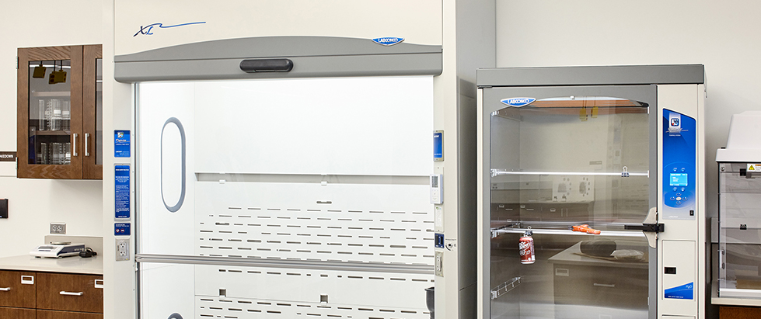
Labconco Products

Slide 5
Intelli-Sash Automatic Sash Position System.

Slide 6
Thank You
(800) 821-5525 • labconco.com

